Slide 1
World Wide Web Web applications
Created by Tomas Hanak

Slide 2
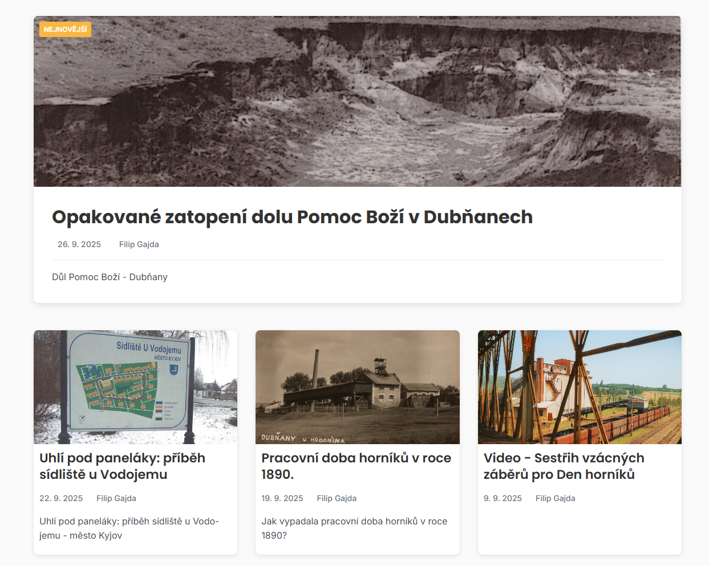
The Idea
Problem: no quality app for custom interactive maps
Our solution: LCIM (Life Changing Interactive Map)
Changes how people think about maps
Web about mines

Slide 3

Demo
Live demo: mapa.jmld.cz
Edit mode: mapa.jmld.cz/login (Credentials: AIT2025/AIT2025)
Confident UX: no tutorial needed
Few clicks to see the difference
Experience interactive mapping first-hand
https://mapa.jmld.cz/

Slide 4
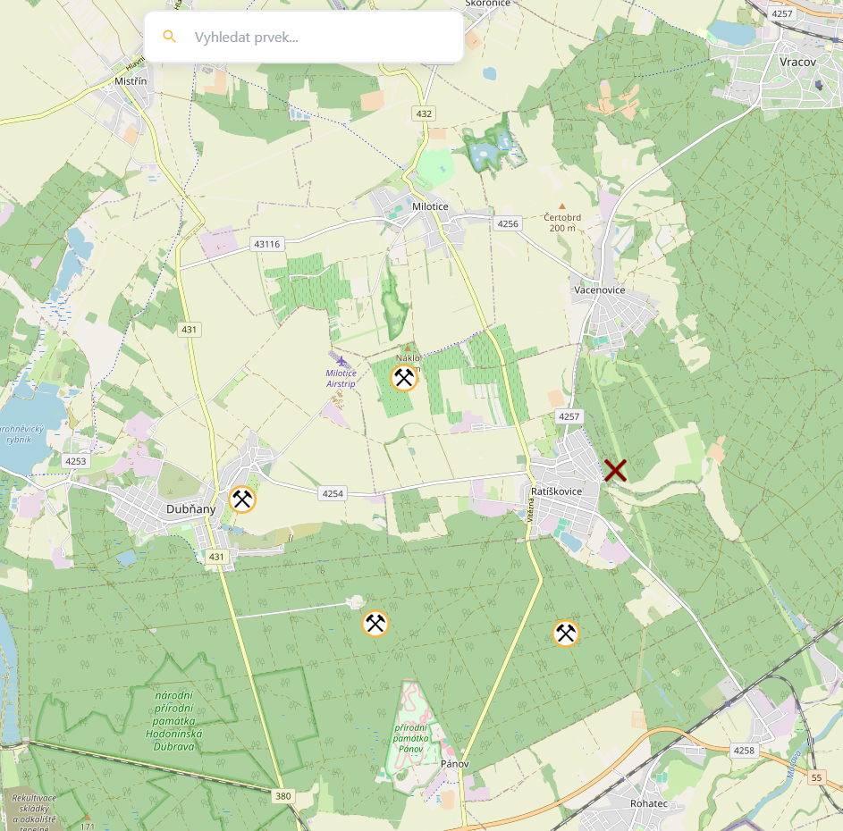
What Is LCIM
Not just another interactive map
Fast, intuitive, modern
Combines open data, smart UX, and speed
Pushes boundaries of web mapping
https://mapa.jmld.cz/

Slide 5
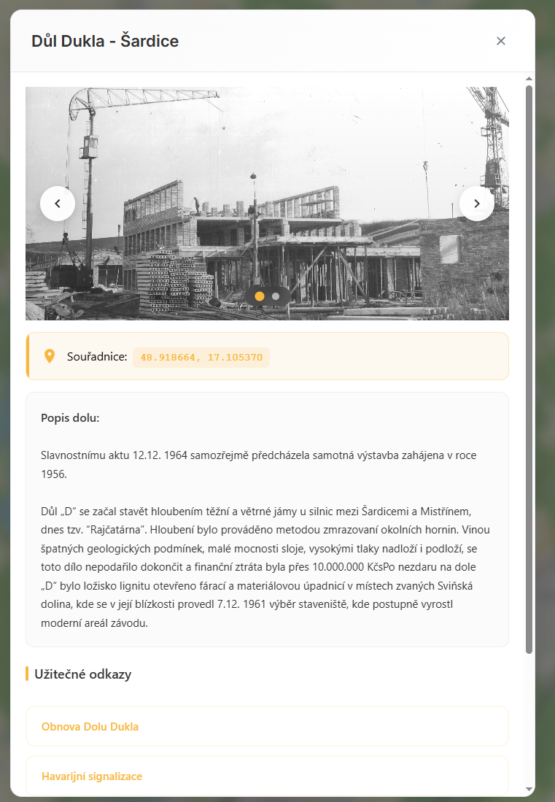
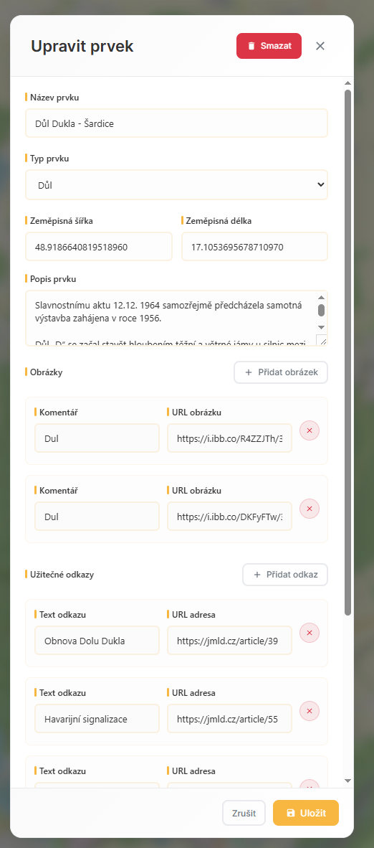
Key Features
Multiple base maps and layers
Custom icons and colours
Smart search and link sharing
Modern UX/UI design
Highly customizable
https://mapa.jmld.cz/

Slide 6
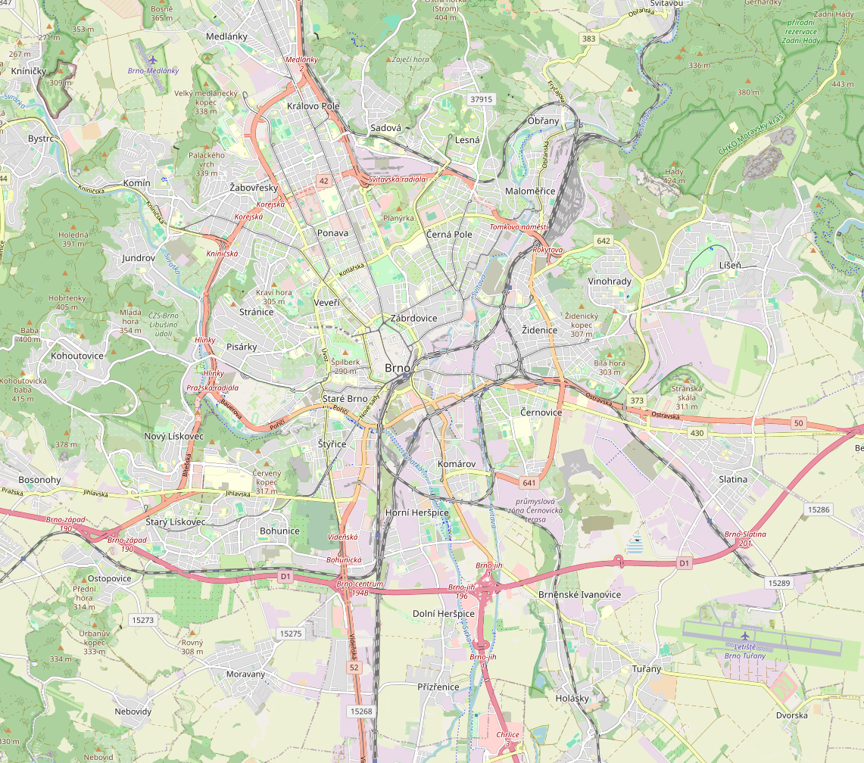

Use Cases & Plans
Tourism projects, community mapping, city planning
Restaurants: easily show branch locations
Local Plan: data stored on your own server
Online Plan: cloud-based, fast, reliable
Integration with company accounts

Slide 7
100% Satisfied Customers*
*We have only one customer

Slide 8

Try it today!

